Slide 1

Part 3
Management: Empowering People to Achieve Business Objectives

Slide 2
Chapter 9
Human Resource Management, Motivation, and Labor-Management Relations

Slide 3

Chapter Objectives
Explain the importance of human resource management, the responsibilities of human resource managers, and the role of human resource planContingentn organization’s competitive strategy.
Describe how recruitment and selection, training, and evaluation contribute to placing the right person in a job.
Outline the methods employers use to compensate employees through pay systems and benefit programs.
Discuss employee separation and the impact of downsizing and outsourcing.
Explain how Maslow’s hierarchy of needs theory, job design, and managers’ attitudes relate to employee motivation.

Slide 4
Chapter Objectives
Summarize the role of labor unions and list their primary goals.
Outline the tactics of labor and management in conflicts between them.
Describe employee-management relations in nonunion organizations.

Slide 5
Human Resource Management Is Vital to All Organizations
Human resource management—function of attracting, developing, and retaining enough qualified employees to perform the activities necessary to accomplish organizational objectives.
Human resource managers responsible for:
  Developing specific programs and activities
  Creating a work environment that generates employee satisfaction and efficiency
Notes:
Organizations devote considerable attention to attracting, training, and retaining employees to help maintain their competitiveness.
Human resource managers are responsible for recruiting, selecting, training, compensating, terminating, and motivating employees.
They accomplish these tasks by developing specific programs and creating a work environment that generates employee satisfaction and efficiency.

Slide 6
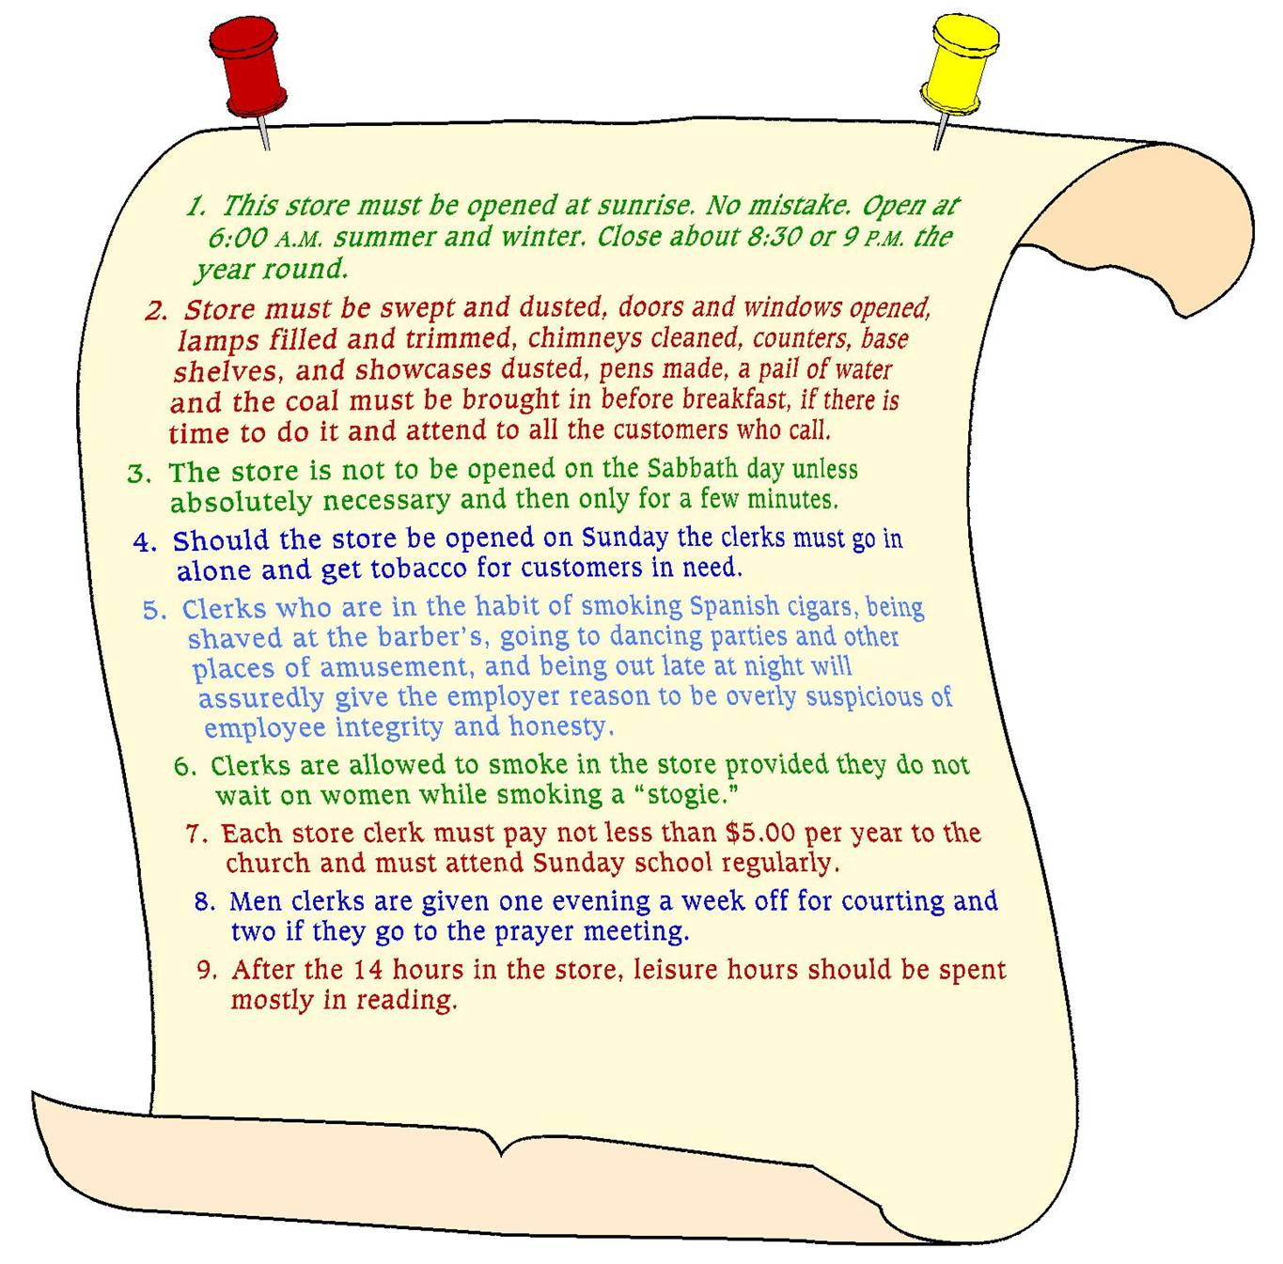
Rules for Clerks, 1905
Notes:
Challenges Facing Human Resource Managers
1. Profound changes in the makeup of the labor force.
2. Shortage of qualified job candidates
3. Changes in the structure of workplaces
4. Employees’ desire to balance work and personal lives
5. An increasingly diverse employee population

Slide 7
Human Resource Management Is Vital to All Organizations
Professional Employer Organizations (PEOs)—company that helps small and mid-sized firms with a wide range of human resource services including hiring and training employees, administering payroll and benefits programs, handling workers’ compensation and unemployment insurance, and maintaining compliance with labor laws
Notes:
PEO can typically negotiate better benefit packages because it represents several clients.
Enables a small firm to focus on production, marketing, and finances.

Slide 8
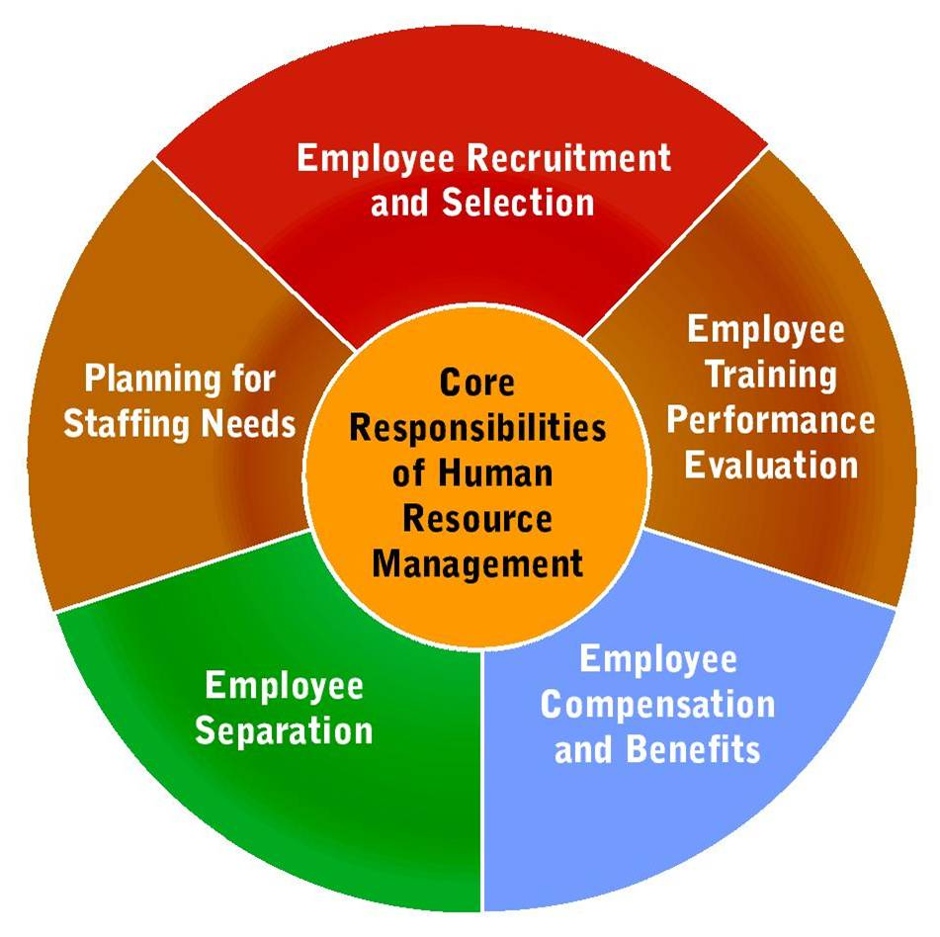
Human Resource Planning

Slide 9
Human Resource Planning
Human Resource Managers:
  Develop staffing plans based on the organization's competitive strategies
  Responsible for adjusting their company’s workforce to meet requirements of:
    Expanding in new markets
    Reducing costs
    Adapting to new technology
  Formulate long and short-term plans to provide needed employees
Notes:
Plan the number of employees and skills needed.
Adjust the workforce to meet changes
Plan how to attract and keep good employees
a. Right combination of pay, benefits and working conditions
b. Create and market the environment to attract the correct employees.

Slide 10
Recruitment and Selection
Human resource managers strive to match applicants’ skills with organizational needs
  Finding Qualified Candidates
  Selecting and Hiring Employees
Notes:
Finding qualified employees
1. Access both internal and external sources to find qualified candidates
2. Recruit internally to save money and boost employee morale
3. Recruit externally:
a. newspaper and trade magazines
b. radio and TV ads
c. college recruiting
d. employment agencies
e. job banks and job fairs
4. Use employee referrals when possible

Slide 11
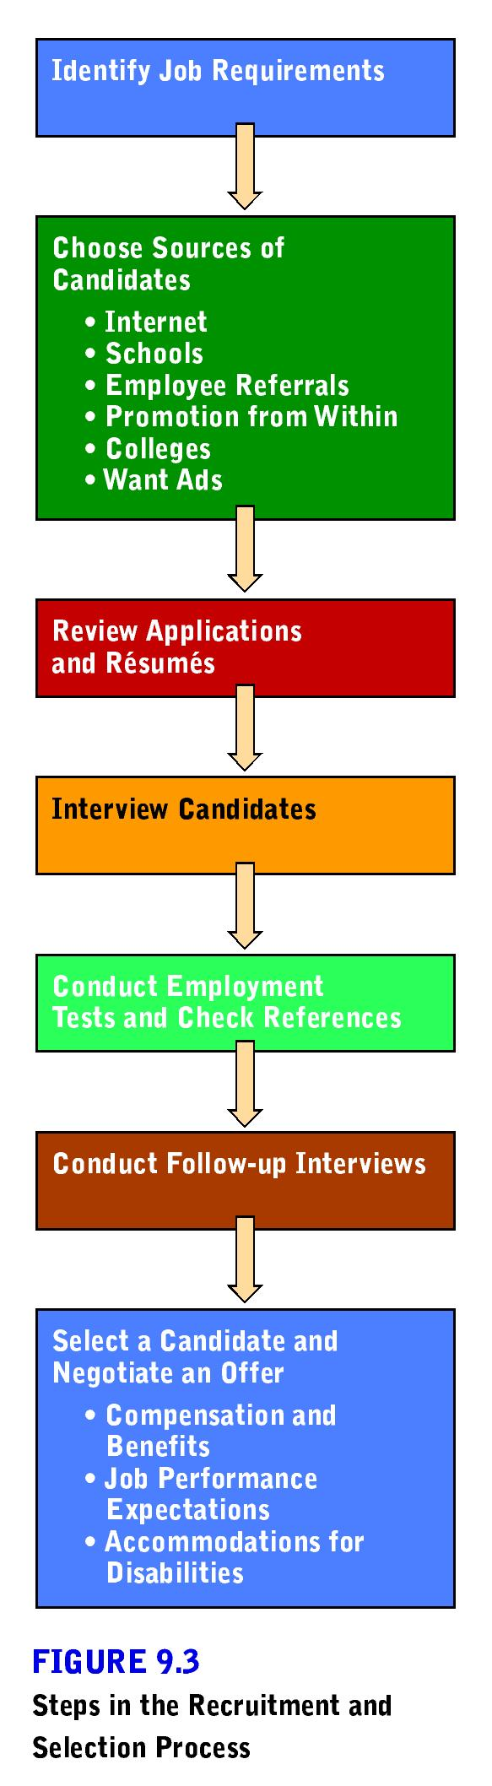
Steps in the Recruitment and Selection Process

Slide 12
Recruitment and Selection
Finding Qualified Candidates
  Access internal and external sources
  Consider internal employees first
  Look outside if qualified candidates not available internally

Slide 13
Recruitment and Selection
Selecting and Hiring Employees
  Must follow the requirements set by federal and state law
  Some firms try to screen out employees by requiring drug testing or employment tests for job applicants
    Employment at will—practice that allows the employment relationship to begin or end at any time at the decision of either the employee or the employer for any reason
Notes:
Selecting and Hiring Employees
1. Title VII of the Civil Rights Act of 1964 prohibits employers from discriminating against applicants based on their race, religion, color, sex, or national origin.
2. The Americans with Disabilities Act of 1990 prohibits discrimination against disabled applicants.
3. The Civil Rights Act created the Equal Employment Opportunity Commission (EEOC) to investigate discrimination complaints and assist employers in establishing affirmative action programs to increase job opportunities for those in protected groups.
4. The Civil Rights Act of 1991 expanded the remedies available to victims of employment discrimination.
5. Fines, penalties, bad publicity and poor employee morale are all potential consequences of failing to comply.
6. Increases in protected employees and discrimination lawsuits have increased the importance of human resource management. The law prohibits asking questions related to: marital status, number of children, race, nationality, religion, age, criminal records, mental health histories, alcohol-related problems
7. HR managers help establish systems to promote fair employment practices: drug testing remains controversial or use of polygraphs
8. Recruitment and Selection is expensive; although a bad hiring decision is even more expensive.
a. Employment tests are used to reduce hiring mistakes.
b. “Employment-at-Will” policies, which are being used more frequently, means the employment relationship can be started or terminated at any time by either party for any reason.

Slide 14

Orientation, Training, and Evaluation
Training builds skills and knowledge that will prepare employees for new job opportunities
  New Horizons: Communicating the Importance of Training
Notes:
Human resource managers use a variety of training techniques including on-the-job training, computerized training programs, and classroom methods.
Employees are requesting more training to advance their skills.
Training is a good investment from the employers point of view.
Should be viewed as an on-going process.
Training is especially significant in the IT (information technology) fields.

Slide 15
Orientation, Training, and Evaluation
On-the-job training prepares employees for job duties by allowing them to perform the tasks under the guidance of experienced employees
Classroom and Computer-Based Training Forms of classroom instruction such as lectures, conferences, audiovisual aids, programmed instruction, and special machines to teach employees everything from basic math and language skills to complex, highly skilled tasks
Notes:
On-the-Job Training
Apprenticeships are a variation in which the employee serves as an assistant to the trained employee
Classroom and Computer-Based Training
a. could involve lectures, conferences, audiovisual aids, programmed instruction, and special machines
b. can reduce costs by reducing travel and employee time away from work
c. can simulate real-life work conditions
d. frequently uses the Internet
e. especially useful in helping prepare managers for overseas assignments

Slide 16
Orientation, Training, and Evaluation
Management development program: training designed to improve the skills and broaden the knowledge of current and potential executives
  Benchmarking
Notes:
Provide training designed to improve the skills and broaden the knowledge of current and potential executives
Especially important because traditional methods of securing executives are not as plentiful currently
Often conducted off the company premises
May include the use of counseling

Slide 17
Orientation, Training, and Evaluation
Performance Appraisals—evaluation of an employee’s job performance by comparing actual results with desired outcomes.
  Based on this evaluation, managers make objective decisions about compensation, promotions, additional training needs, transfers, or firings
  360-degree performance review: process that gathers feedback from a review panel of about 8 to 12 people, including co-workers, team members, subordinates, and sometimes customers

Slide 18

Compensation
Wage—compensation based on an hourly pay rate or the amount of output produced.
Salary—compensation calculated on a periodic basis, such as weekly or monthly.
Living wage
Notes:
HR managers strive to develop equitable compensation systems that include wages and salaries, plus benefits that will attract and keep competent employees.

Slide 19
Compensation
Most firms base their compensation policies on five factors:
  Salaries and wages paid by others
  Government legislation
  Cost of living
  Firm’s ability to pay
  Worker productivity
Notes:
Five factors are typically used in determining compensation policies, including:
1. salaries and wages paid by other companies that compete for the same people
2. government legislation, including federal, state, or local minimum wage
3. the cost of living
4. the firm’s ability to pay
5. worker productivity

Slide 20
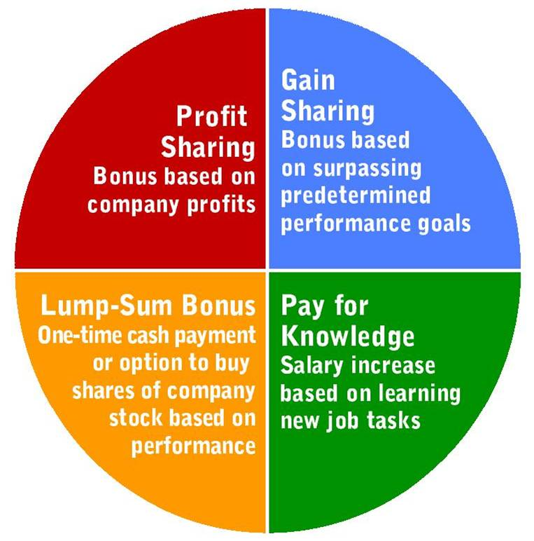
Four Forms of Incentive Compensation
Notes:
In an effort to link compensation with methods to motive workers, several strategies have been developed, including:
1. profit sharing – awards bonuses based on company profits
2. gain sharing – awards bonuses based on surpassing predetermined performance goals
3. lump-sum bonuses – awards of one-time cash payments based on performance
4. pay for knowledge – distributes wage and salary increases as new job tasks are mastered
5. Stock options are also used in larger companies by allowing executives to purchase stock at preset prices within certain time periods
6. The pay levels of executives is growing much faster than those of employees at other organizational levels

Slide 21
Compensation
Employee Benefits—rewards such as retirement plans, health insurance, vacation, and tuition reimbursement provided for employees either entirely or in part at the company’s expense.
  Some benefits, e.g. Social Security contributions, are required by law
Notes:
Benefits programs vary among firms, but most companies offer health care programs, insurance, retirement plans, paid holidays, and sick leave.
A growing number of companies are offering flexible work plans such as flextime, compressed workweeks, job sharing, and home-based work.

Slide 22
Compensation
Flexible benefit plan (cafeteria plan)— benefit system that offers employees a range of options from which they can choose they types of benefits they receive
Flexible work plan—employment that allows personnel to adjust their working hours and places of work to accommodate their personal lives
  Flextime
  Compressed workweek
  Job Sharing
  Home-based work program
Notes:
1. offer workers a range of options from which they can choose various benefits
2. paid time off -- allows workers a bank of time to utilize as they wish for sick days, holidays, vacation days.
3. Flexible Work Plans – benefits that allow employees to adjust their working hours and locations to accommodate their personal lives.
4. flextime – a scheduling system that allows employees to set their own work hours within constraints specified by the firm.
5. compressed workweek – a scheduling option that allows employees to work the regular number of weekly hours in fewer than the typical five days.
6. job sharing – allows two or more employees to divide the tasks of one job.
7. home-based work or telecommuting – allows employees to perform their jobs from home with the use of telephones, e-mail, computers, and faxes.

Slide 23
Employee Separation
Employer or employee can take the initiative to terminate employment
  Exit interview—conversation designed to find out why an employee decided to leave
Downsizing—process of reducing the number of employees within a firm by eliminating jobs.
Notes:
Downsizing
Utilize various techniques, including:
early retirement voluntary severance programs
opportunities for internal reassignment
assisting valued employees in securing positions with other firms
Downsize for various reasons, including:
to reduce overhead costs
streamline the organizational structure
Disadvantages to downsizing include:
losing valuable employees
reduced employee morale
fear about job security eroding employee commitment and productivity

Slide 24
Employee Separation
Outsourcing—practice of contracting out work previously performed by company employees.
  Complements today’s focus on business competitiveness and flexibility
Using Contingent Workers
  Contingent worker—employee who works part time, temporarily, or for the period of time specified in a contract.

Slide 25
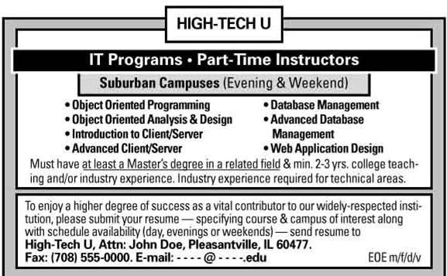

Current Want-Ads for Contingent Workers

Slide 26

Motivating Employees
Effective human resource management makes important contributions to employee motivation
Morale—mental attitude of employees toward their employer and jobs.
Notes:
The three “Rs” have been identified as important aspects of motivating staff and increasing employee morale – the mental attitude employees have toward their employer and jobs. They are:
1. expanding workers’ responsibility for their jobs
2. sharing rewards that the firm generates as fairly as possible
3. ensuring the workers’ rights are protected

Slide 27
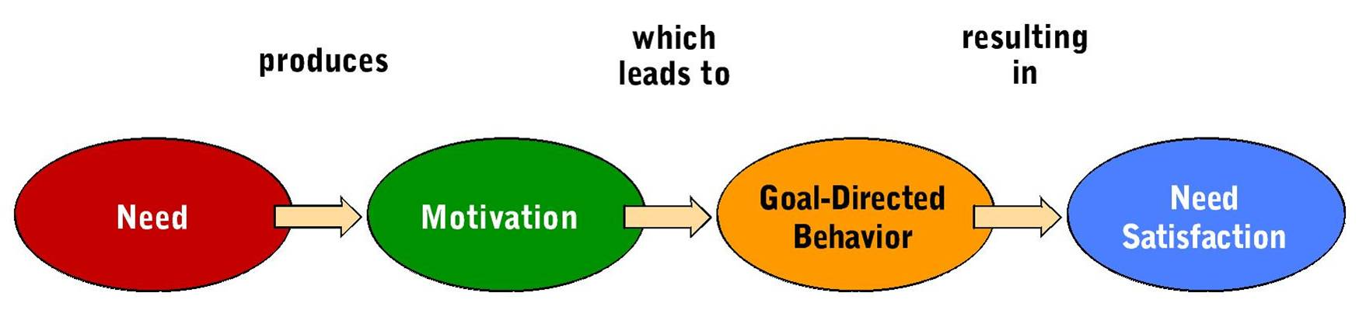
Motivating Employees
Need—simply a lack of some useful benefit
Motive—inner state that directs a person toward the goal of satisfying a felt need
The Process of Motivation
Notes:
All employees have needs, and these needs differ among employees.
Each person is motivated to take actions that satisfy his or her needs.
Employers who recognize and understand differences in employee needs can develop programs that satisfy different needs and motivate workers to achieve organizational goals.

Slide 28
Motivating Employees
Maslow’s Hierarchy of Needs Theory
  According to the theory, people have five levels of needs that they seek to satisfy:
    Physiological
    Safety
    Social
    Esteem
    Self-actualization
Notes:
Based on three assumptions, including:
a. People are wanting animals whose needs depend on what they already possess.
b. A satisfied need is not a motivator; only unsatisfied needs can influence behavior.
c. Human needs are arranged in a hierarchy, and must be satisfied in descending order.

Slide 29
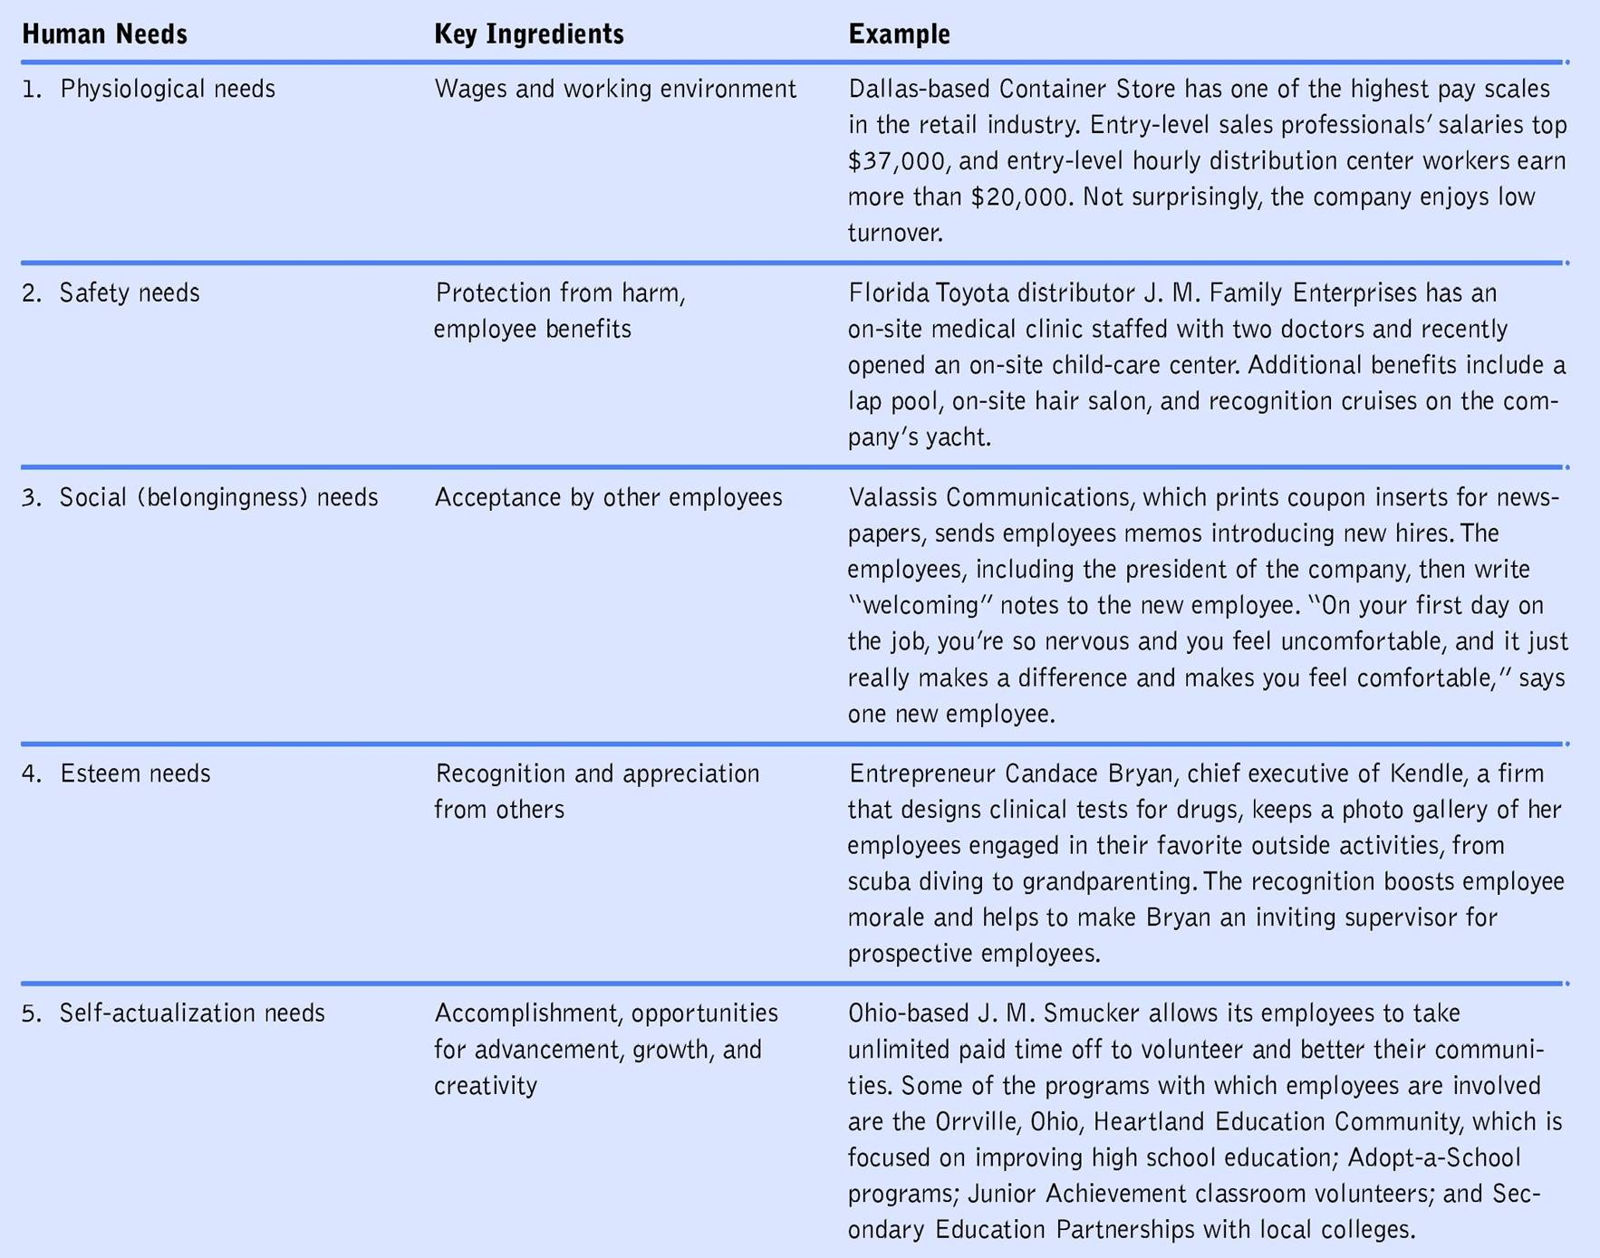
Notes:
physiological needs
the most basic human needs of food, shelter, and clothing
in the workplace these needs are satisfied by salaries and wages, and establishing comfortable working environments
safety needs
refer to desires for physical and economic protection
satisfied in the workplace by providing benefits such as retirement plans, job security and workplaces that comply with OSHA standards
social or belongingness needs
a. the desire for acceptance by others
b. met at work by assisting employees in maintaining good relationships with colleagues and participating in good activities
esteem needs--the need to receive attention, recognition and appreciation from others
self-actualization needs
drive people to seek fulfillment, realize potentials, utilize talents and capabilities
employers can offer challenging, creative and meaningful work assignments and opportunities for advancement based on individual merit

Slide 30
Motivating Employees
Job Design and Motivation
  Job enlargement—job design that expands an employee’s responsibilities by increasing the number and variety of tasks they entail.
  Job enrichment—change in job duties to increase employee’s authority in planning their work, deciding how it should be done, and learning new skills.

Slide 31
Motivating Employees
Manager’s Attitudes and Motivation
Worker motivation is influenced by the attitudes that managers display towards employees
  Theory X—assumption that employees dislike work and will try to avoid it
  Theory Y—assumption that employees enjoy work and seek social, esteem, and self-actualization fulfillment
  Theory Z—assumption that employee involvement is key to productivity and quality of work life
Notes:
Theory X
assumes that employees dislike work and whenever possible try to avoid it
thus, these managers must closely monitor their subordinates, use threats of or actual disciplinary action, and demand close adherence to policies and procedures
Theory Y
assumes that the typical person likes work and learns, under proper conditions to accept and seek out responsibilities to fulfill social, esteem, and self-actualization needs
emphasizes self-control and self-direction among employees
includes workers in decision making
believes that if workers are not performing that there must be barriers in the ways, which become the shared responsibility of the manager and worker to remove
William Ouchi postulated Theory Z, which states that employee involvement is the key to productivity and the quality of work life

Slide 32
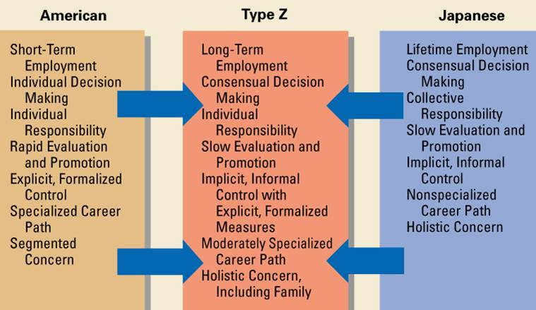
Theory Z Management: A Blend of American and Japanese Methods

Slide 33

Union-Management Relations
Development of Labor Unions
  Labor Unions—group of workers who have banded together to achieve common goals in the areas of wages, hours, and working conditions.
  AFL—CIO
Notes:
Attempts to form labor unions began in the 19th century to improve pay and working conditions.
Two types of unions emerged: craft unions joined skilled workers in crafts or trades; industrial unions joined workers from different occupations in the same industry.
Unions grew slowly until 1935. From 1935 to 1955, they experienced their greatest period of growth. Since then union membership has steadily declined.
Unions have a hierarchical structure. At the base is the local union that operates in a given geographical area. Most local unions constitute a national union. An international union joins members from multiple countries. At the top of the hierarchy is the federation, an association such as the AFL-CIO, which consists of many national and international unions.

Slide 34

The World’s Tallest Roller Coaster: Union-Made at Cedar Point Amusement Park, Sandusky, OH

Slide 35
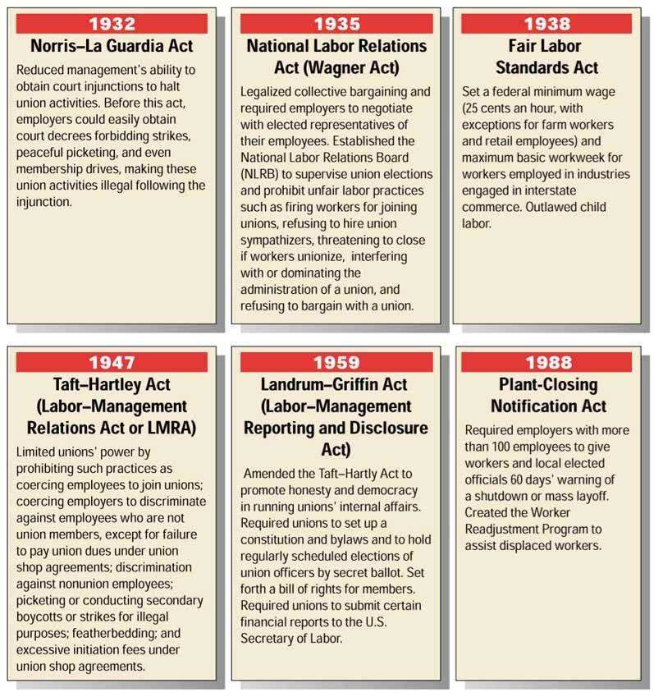
Labor Legislation
Notes:
The Norris-La Guardia Act of 1932 protects unions by reducing management’s ability to stop union activities.
The National Labor Relations Act (Wagner Act) of 1935 requires management to bargain collectively with elected employee representatives and outlaws a number of unfair management practices.
The Fair Labor Standards Act of 1938 set a federal minimum wage and outlawed child labor.
In efforts to balance power between labor and management, the Taft-Hartley Act of 1947 and the Landrum-Griffin Act of 1959 were passed to outlaw a number of unfair labor practices of unions and employers.
The Plant Closing Notification Act of 1988 requires any employer with more than 100 employees to give 60 days’ notice before a plant shutdown or mass layoff.

Slide 36
Union-Management Relations
Collective Bargaining Process
  Collective Bargaining—process of negotiation between management and union representatives for the purpose of arriving at mutually acceptable wages and working conditions for employees.
Notes:
Union representatives and employers negotiate their demands during collective bargaining sessions. The agreement that they reach is set forth in a contract that is accepted or rejected by a vote of union members. Contracts cover wages and benefits, working conditions, grievance handling and arbitration, union activities and responsibilities, and employee rights and seniority.

Slide 37
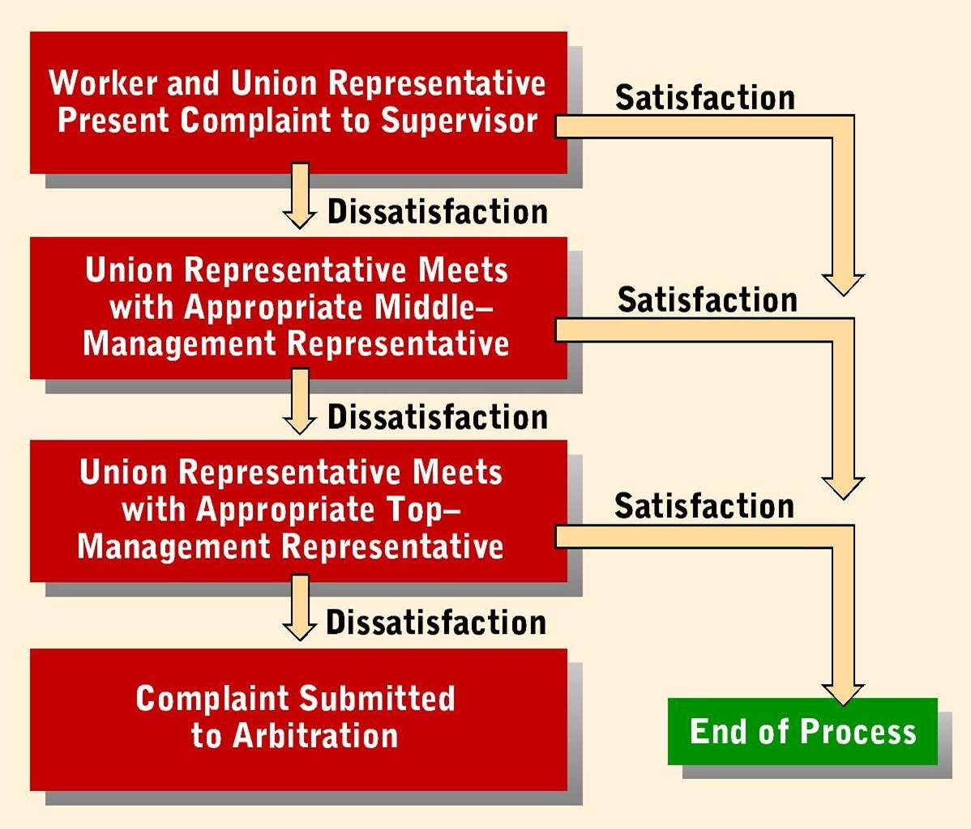
Steps in the Grievance Procedure

Slide 38
Union-Management Relations
Settling Union-Management Disputes
  Grievance—formal complaint filed by an employee or a union that management is violating some provision of a union contract.
  Mediation—process which brings in a third party, called a mediator, to make recommendations for settling differences
  Arbitration—bringing in an impartial third party called an arbitrator to render a binding decision in the dispute
Notes:
Mediators and arbitrators assist negotiations.
A mediator offers advice and makes recommendations.
An arbitrator listens to both sides and then makes a decision that becomes binding for both parties.

Slide 39
Union-Management Relations
Competitive Tactics of Unions and Management
Union Tactics
  Strike (walkout)—temporary work stoppage by employees until a dispute is been settled or a contract signed
  Picketing—workers marching at a plant entrance to protest some management practice
  Boycott—effort to prevent people from purchasing a firm’s goods or services
Notes:
Although most differences between labor and management are settled through the collective bargaining or grievance process, both unions and management have other ways of making their demands known.
The chief tactics of unions are the strike, picketing, and the boycott.

Slide 40
Union-Management Relations
Competitive Tactics of Unions and Management
Management Tactics
  Lockout—a management strike to bring pressure on union members by closing the firm
    Strikebreakers
  Injunction—court order prohibiting some practice – to prevent excessive picketing or certain unfair union practices
  Employers’ associations—employers group that cooperates and presents a united front in dealing with labor unions
Notes:
Management’s weapons are hiring strikebreakers, petitioning courts for injunctions, locking out workers, and forming employers’ associations.

Slide 41
Union-Management Relations
Employee-Management Relations in Nonunion Organizations
  Nonunion companies often offer compensation and benefits comparable to those of unionized firms to avert unionization
Notes:
Employees in many small firms and many occupational groups, including managers, are not union members.
Employers in nonunion settings try to prevent unionization by satisfying employees with competitive wages and benefits.
Employers help employees resolve grievances through a number of boards, mediation, and arbitration.
Some employers that reduce their workforces offer employees incentives for early retirement and resignation, rather than using involuntary layoffs.

Slide 42
Union-Management Relations
Employee-Management Relations in Nonunion Organizations
  Grievance Programs for Nonunion Employees
    Open-door policies
    Employee hotlines
    Peer review boards
    Mediation and arbitration

Slide 43
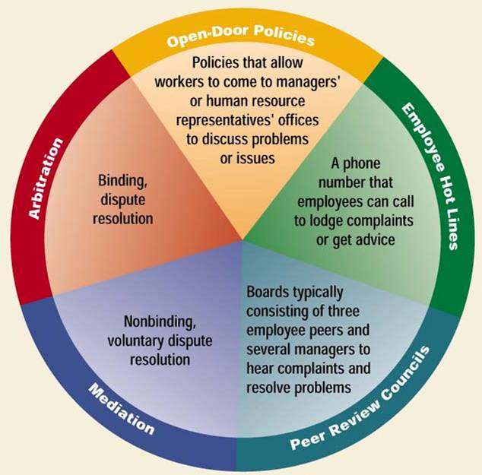
Grievance Programs for Nonunion Employees

Slide 44
Union-Management Relations
Employee-Management Relations in Nonunion Organizations
  Job Security in Nonunion Companies
    Primary motivation for workers to form labor unions
    To reduce staffing levels, firms may try to provide alternatives to layoffs

